Slide 1
Functions
Do things

Slide 2
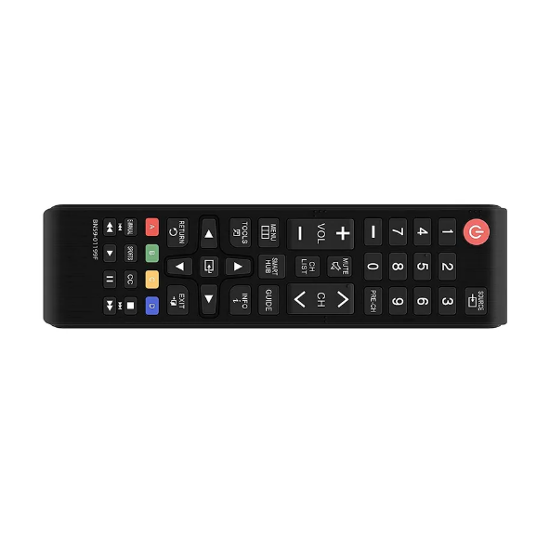
What is a function?
If a variable IS something, then a function DOES something
turnTvOn
👇

Slide 3
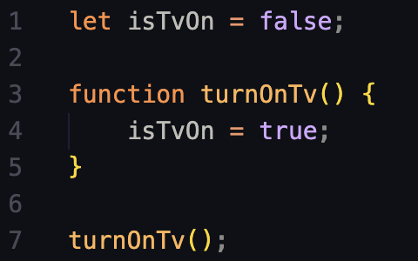
Let consider this example:
👇
🧹⚡️

Slide 4
How does this code work?
Let’s read it like the computer does.

Slide 5

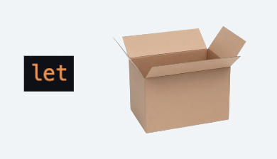
Let's read the instructions like the computer would:
Variable declaration
With the “let” keyword we tell the computer to create a variable

Slide 6
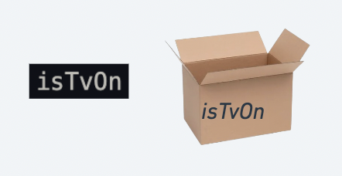
Let's read the instructions like the computer would:
Variable declaration
We give the variable a name

Slide 7
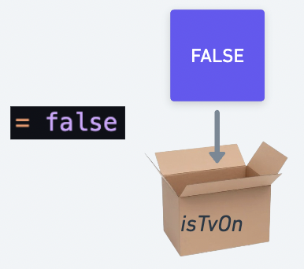
Let's read the instructions like the computer would:
Variable declaration
We assign a value to the variable with the equality operator (=)

Slide 8
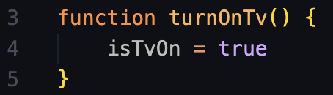
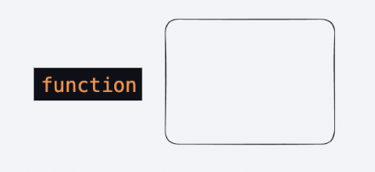
Let's read the instructions like the computer would:
Function declaration
The “function” keyword is used to tell the computer to remember (save to memory) whatever comes next.
Just like “const” or “let”

Slide 9
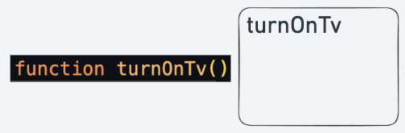
Let's read the instructions like the computer would:
Function declaration
We give the function a name. It must always end with parenthesis ()

Slide 10
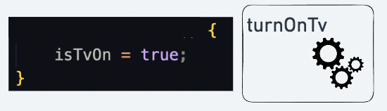
Let's read the instructions like the computer would:
Function declaration
The code between the curly braces {} is the “body” of the function. We want the computer to remember this block of code. Just like a variable holds a value.
This code won’t run (yet).

Slide 11

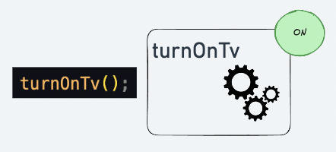
Let's read the instructions like the computer would:
Function call
To run the code inside the “body”, we must “call” the function.
To call a function we write the name of the function, including the parenthesis ()

Slide 12
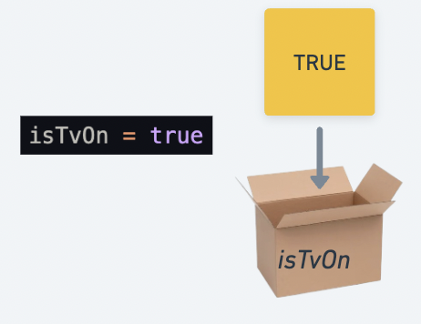
Let's read the instructions like the computer would:
Function call
The code inside the body runs. We assign a new value to our variable

Slide 13
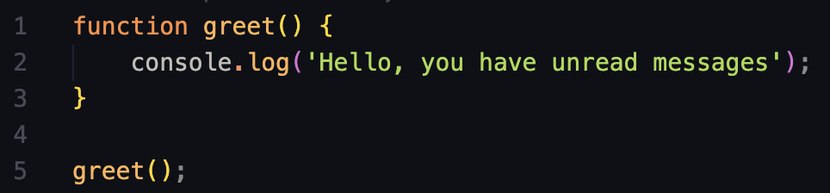
Another example

